Slide 1
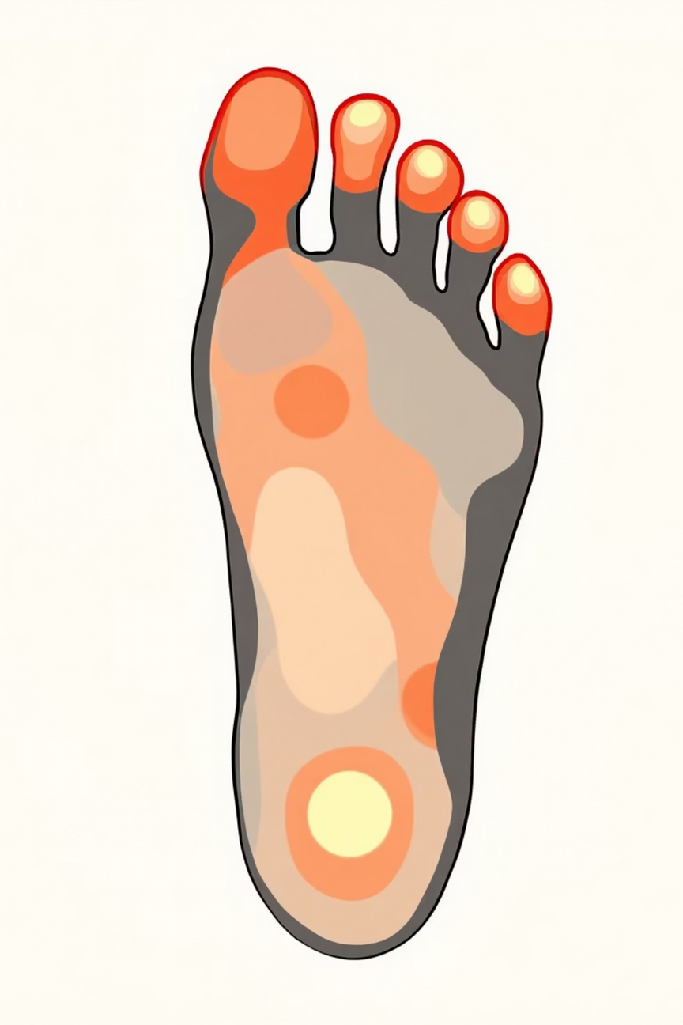
Introduction
Diabetes mellitus is a chronic metabolic disorder affecting millions worldwide.
One of its serious complications is diabetic peripheral neuropathy, which can lead to foot ulcers and amputations.
Early identification of abnormal foot conditions is crucial to prevent severe outcomes.
Infrared thermal imaging provides a non-invasive, contactless, and safe method to observe foot temperature patterns.

Slide 2
Motivation and Project Focus
Neuropathic changes often manifest as thermal asymmetry and hotspots in thermal foot images.
Manual interpretation of thermal images is subjective and requires expert knowledge.
Machine learning and deep learning can automate thermal pattern analysis.
This project focuses on risk classification (Low / Moderate / High), not medical diagnosis.

Slide 3
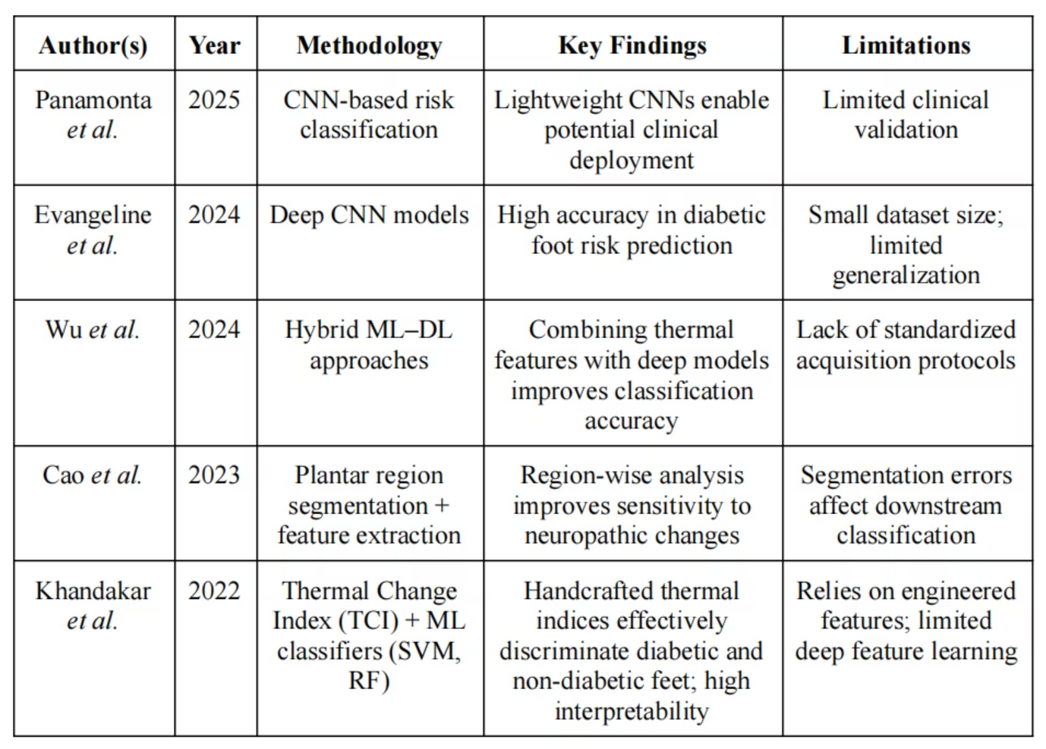
Literature Review: Existing Research

Slide 4

Identified Research Gap
Risk Stratification
CNN Output Integration
Most existing works focus on binary diagnosis, not risk stratification.
Limited integration of CNN outputs with global thermal statistical features.
Lightweight CNN Benchmarking
Project Focus
Few studies benchmark lightweight CNNs for thermal foot images.
This project addresses these gaps through a hybrid, risk-based framework.

Slide 5
System Requirements and Analysis: Functional Requirements
  Load and preprocess thermal foot images.
  Perform data augmentation to expand dataset and improve generalization.
  Train CNN-based binary classifiers.
  Extract global thermal features from images based on medical thermography methods.
  Generate risk scores based on classifier output and global thermal features and classify risk levels.

Slide 6
Non-Functional Requirements
Reliability & Reproducibility
Efficient Computation
High reliability and reproducibility of results.
Efficient computation suitable for limited resources.
Modular & Scalable
Validity & Ethics
Modular and scalable system design.
Validation of outputs for medical relevance.

Slide 7
Tools and Technologies Used: Software and Frameworks
Programming Language
Python
Deep Learning Framework
TensorFlow / Keras
Image Processing
NumPy, OpenCV
Visualization
Matplotlib
Model Evaluation
Scikit-learn

Slide 8
Models and Platform
Pretrained CNN Architectures:
Training Platform:
  EfficientNet-B0
  Google Colab, VS Code
  MobileNetV2
Dataset Handling:
  Directory-based generators
Experiment Management:
  Versioned model saving and experiment logging

Slide 9
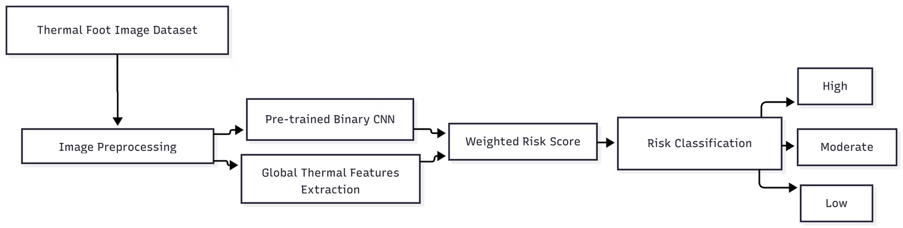
System Design
  CNNs learn complex spatial thermal patterns.
  Global thermal features add physiological interpretability.
  Hybrid design improves robustness.
  Risk-based output avoids clinical overclaiming.
  Modular pipeline enables easy extension.

Slide 10
System Implementation: Model Training Implementation
  Images resized to 224×224 and normalized.
  Binary classifiers trained using augmented dataset.
  Two-phase training:
    Feature extraction phase
    Fine-tuning phase
  Performance tracked using accuracy, AUC, precision, NPV, and F1-score.
Output Generation and Storage
  Automatic saving of:
    Trained models
    Training logs
    Performance plots
    Evaluation metrics
  Structured version-wise folder organization.
  Final output includes:
    Binary classification results
    Risk score inputs for further analysis

